Slide 1
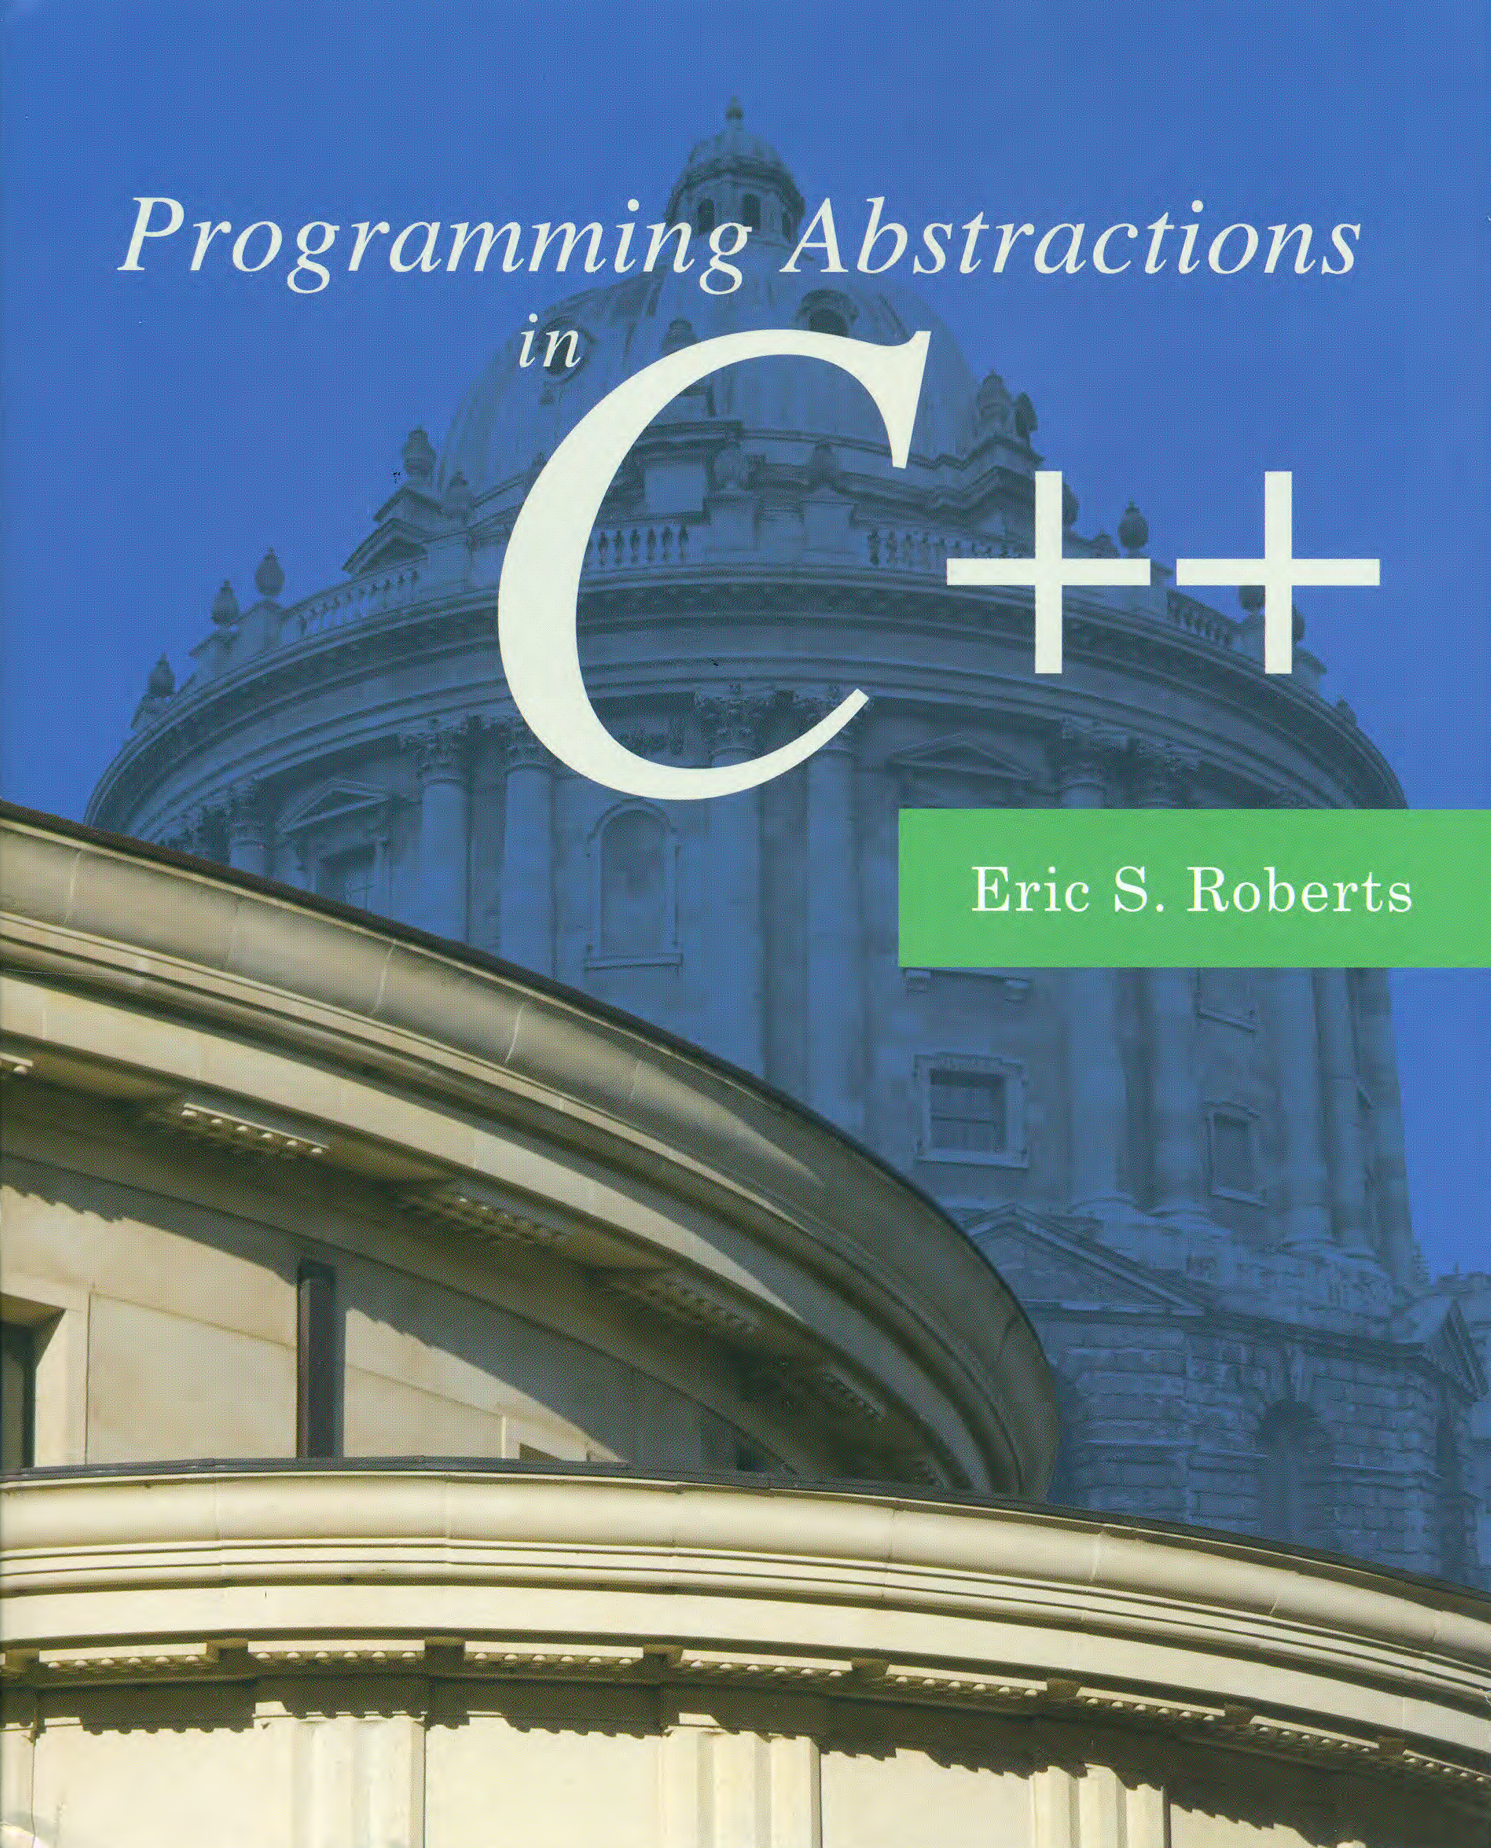
Strategies for Iteration
C H A P T E R 20
What needs this iteration.
—William Shakespeare, Othello, ~1603
20.1 Using iterators
20.2 Implementing iterators
20.3 Using functions as data values
20.4 Encapsulating data with functions
20.5 The STL algorithm library
20.6 Functional programming in C++

Slide 2
Introduction to the C++ Libraries
A collection of classes and functions, which are written in the core language and part of the C++ ISO Standard (98/11) itself. Features of the C++ Standard Library are declared within the std namespace
Containers: vector, list, queue, stack, map, set, etc.
General: algorithm, functional, iterator, memory, etc.
Strings
Streams and Input/Output: iostream, fstream, sstream, etc.
Localization
Language support
Thread support library
Numerics library
C standard library: cmath, cctype, cstring, cstdio, cstdlib, etc.

Slide 3
Example: TwoLetterWords
Flashback
/* Program to generate all the two-letter English words */
#include <iostream>
#include "lexicon.h"
//#include "foreach.h" /* range-based for in Stanford */
using namespace std;
int main() {
Lexicon english("EnglishWords.dat");
string word("aa");
for (char c0 = 'a'; c0 <= 'z'; c0++) {
word[0] = c0;
for (char c1 = 'a'; c1 <= 'z'; c1++) {
word[1] = c1;
if (english.contains(word)) cout << word << endl;
}
}
// foreach (string word in english) { /* Stanford */
for (string word : english) { /* C++11 */
if (word.length() == 2) {
cout << word << endl;
}
}
return 0;
}

Slide 4
Using Iterators in C++
When you work with strings, one of the most important patterns involves iterating through the characters in a string, which requires the following code (index-based loop):
For collection classes, the range-based for loop looks like:
The C++ compiler translates the range-based for loop using iterators, which looks like this:
for (int i = 0; i < str.length(); i++) {
. . . Body of loop that manipulates str[i] . . .
}
for (string word : lexicon) {
. . . Body of loop involving word . . .
}
for (Lexicon::iterator it = lexicon.begin();
it != lexicon.end(); it++) {
. . . Body of loop involving *it . . .
}

Slide 5
Using Iterators in C++
The C++ Standard Template Library makes extensive use of an abstract data type called an iterator, which supports stepping through a collection one element at a time.
Every collection class in the STL exports an iterator type (a nested type) along with two standard methods that produce iterators. The begin method returns an iterator positioned at the beginning of the collection. The end method returns an iterator positioned just past the final element.
Iterators in C++ use a syntax derived from pointers. Given an iterator, one reads the corresponding value by dereferencing the iterator variable and increments it using the ++ operator. The pattern for using an iterator to loop over a collection c is:
for (ctype::iterator it = c.begin(); it < c.end(); it++) {
. . . Body of loop involving *it . . .
}

Slide 6
Example: TwoLetterWords
int main() {
Lexicon english("EnglishWords.dat");
for (Lexicon::iterator it = english.begin(); it != english.end(); it++) {
string word = *it;
if (word.length() == 2) {
cout << word << endl;
}
if (it->length() == 2) {
cout << *it << endl;
}
}
Lexicon::iterator it = english.begin();
while (it != english.end()) {
string word = *it++;
if (word.length() == 2) {
cout << word << endl;
}
if (it->length() == 2) {
cout << *it++ << endl;
}
}
return 0;
}

Slide 7
The C++ Iterator Hierarchy
InputIterator
OutputIterator
*it (read only)
it++
it->field
*it = value
it++
it₁ == it₂
it₁ != it₂
it₁ == it₂
it₁ != it₂
ForwardIterator
BidirectionalIterator
it--
RandomAccessIterator
it + n
it – n
it += n
it -= n
it₁ – it₂
it₁ < it₂
it₁ <= it₂
it₁ > it₂
it₁ >= it₂

Slide 8
Example: The Vector Iterator
The Lexicon class supports only the InputIterator level of service, while the iterator for the Vector class is a RandomAccessIterator.
Using iterators in such unusual ways often ends up making programs difficult to maintain, much like code that tries to be too clever with its pointer manipulation. The best way to specify iteration is to use the (range-based) for loop whenever you can, because doing so hides the iterators altogether.
Vector<int>::iterator it = v.end();
while (it != v.begin()) {
cout << *--it << endl;
}
for (Vector<int>::iterator it = v.begin(); it < v.end(); it += 2) {
cout << *it << endl;
}

Slide 9
Implementation of the Vector Iterator
/*
* Nested class: iterator
* ----------------------
* This nested class implements a standard iterator for the Vector class.
*/
class iterator {
public:
/*
* Implementation notes: iterator constructor
* ------------------------------------------
* The default constructor for the iterator returns an invalid iterator
* in which the vector pointer vp is set to NULL. Iterators created by
* the client are initialized by the constructor iterator(vp, k), which
* appears in the private section.
*/
iterator() {
this->vp = NULL;
}

Slide 10
Implementation of the Vector Iterator
/*
* Implementation notes: dereference operator
* ------------------------------------------
* The * dereference operator returns the appropriate index position in
* the internal array by reference.
*/
ValueType & operator*() {
if (vp == NULL) error("Iterator is uninitialized");
if (index < 0 || index >= vp->count) error("Iterator out of range");
return vp->array[index];
}
/*
* Implementation notes: -> operator
* ---------------------------------
* Overrides of the -> operator in C++ follow a special idiomatic pattern.
* The operator takes no arguments and returns a pointer to the value.
* The compiler then takes care of applying the -> operator to retrieve
* the desired field.
*/
ValueType *operator->() {
if (vp == NULL) error("Iterator is uninitialized");
if (index < 0 || index >= vp->count) error("Iterator out of range");
return &vp->array[index];
}
/*
* Nested class: iterator
* ----------------------
* This nested class implements a standard iterator for the Vector class.
*/
class iterator {
public:
/*
* Implementation notes: iterator constructor
* ------------------------------------------
* The default constructor for the iterator returns an invalid iterator
* in which the vector pointer vp is set to NULL. Iterators created by
* the client are initialized by the constructor iterator(vp, k), which
* appears in the private section.
*/
iterator() {
this->vp = NULL;
}

Slide 11
Implementation of the Vector Iterator
/*
* Implementation notes: selection operator
* ----------------------------------------
* The selection operator returns the appropriate index position in
* the internal array by reference.
*/
ValueType & operator[](int k) {
if (vp == NULL) error("Iterator is uninitialized");
if (index + k < 0 || index + k >= vp->count) {
error("Iterator out of range");
}
return vp->array[index + k];
}
/*
* Implementation notes: relational operators
* ------------------------------------------
* These operators compare the index field of the iterators after making
* sure that the iterators refer to the same vector.
*/
bool operator==(const iterator & rhs) {
if (vp != rhs.vp) error("Iterators are in different vectors");
return vp == rhs.vp && index == rhs.index;
}
/*
* Implementation notes: dereference operator
* ------------------------------------------
* The * dereference operator returns the appropriate index position in
* the internal array by reference.
*/
ValueType & operator*() {
if (vp == NULL) error("Iterator is uninitialized");
if (index < 0 || index >= vp->count) error("Iterator out of range");
return vp->array[index];
}
/*
* Implementation notes: -> operator
* ---------------------------------
* Overrides of the -> operator in C++ follow a special idiomatic pattern.
* The operator takes no arguments and returns a pointer to the value.
* The compiler then takes care of applying the -> operator to retrieve
* the desired field.
*/
ValueType *operator->() {
if (vp == NULL) error("Iterator is uninitialized");
if (index < 0 || index >= vp->count) error("Iterator out of range");
return &vp->array[index];
}

Slide 12
Implementation of the Vector Iterator
bool operator!=(const iterator & rhs) {
if (vp != rhs.vp) error("Iterators are in different vectors");
return !(*this == rhs);
}
bool operator<(const iterator & rhs) {
if (vp != rhs.vp) error("Iterators are in different vectors");
return index < rhs.index;
}
bool operator<=(const iterator & rhs) {
if (vp != rhs.vp) error("Iterators are in different vectors");
return index <= rhs.index;
}
bool operator>(const iterator & rhs) {
if (vp != rhs.vp) error("Iterators are in different vectors");
return index > rhs.index;
}
bool operator>=(const iterator & rhs) {
if (vp != rhs.vp) error("Iterators are in different vectors");
return index > rhs.index;
}
/*
* Implementation notes: selection operator
* ----------------------------------------
* The selection operator returns the appropriate index position in
* the internal array by reference.
*/
ValueType & operator[](int k) {
if (vp == NULL) error("Iterator is uninitialized");
if (index + k < 0 || index + k >= vp->count) {
error("Iterator out of range");
}
return vp->array[index + k];
}
/*
* Implementation notes: relational operators
* ------------------------------------------
* These operators compare the index field of the iterators after making
* sure that the iterators refer to the same vector.
*/
bool operator==(const iterator & rhs) {
if (vp != rhs.vp) error("Iterators are in different vectors");
return vp == rhs.vp && index == rhs.index;
}

Slide 13
Implementation of the Vector Iterator
/*
* Implementation notes: ++ and -- operators
* -----------------------------------------
* These operators increment or decrement the index. The suffix versions
* of the operators, which are identified by taking a parameter of type
* int that is never used, are more complicated and must copy the original
* iterator to return the value prior to changing the count.
*/
iterator & operator++() {
if (vp == NULL) error("Iterator is uninitialized");
index++;
return *this;
}
iterator operator++(int) {
iterator copy(*this);
operator++();
return copy;
}
bool operator!=(const iterator & rhs) {
if (vp != rhs.vp) error("Iterators are in different vectors");
return !(*this == rhs);
}
bool operator<(const iterator & rhs) {
if (vp != rhs.vp) error("Iterators are in different vectors");
return index < rhs.index;
}
bool operator<=(const iterator & rhs) {
if (vp != rhs.vp) error("Iterators are in different vectors");
return index <= rhs.index;
}
bool operator>(const iterator & rhs) {
if (vp != rhs.vp) error("Iterators are in different vectors");
return index > rhs.index;
}
bool operator>=(const iterator & rhs) {
if (vp != rhs.vp) error("Iterators are in different vectors");
return index > rhs.index;
}

Slide 14
Implementation of the Vector Iterator
iterator & operator--() {
if (vp == NULL) error("Iterator is uninitialized");
index--;
return *this;
}
iterator operator--(int) {
iterator copy(*this);
operator--();
return copy;
}
/*
* Implementation notes: arithmetic operators
* ------------------------------------------
* These operators update the index field by the increment value k.
*/
iterator operator+(const int & k) {
if (vp == NULL) error("Iterator is uninitialized");
return iterator(vp, index + k);
}
iterator operator-(const int & k) {
if (vp == NULL) error("Iterator is uninitialized");
return iterator(vp, index - k);
}
/*
* Implementation notes: ++ and -- operators
* -----------------------------------------
* These operators increment or decrement the index. The suffix versions
* of the operators, which are identified by taking a parameter of type
* int that is never used, are more complicated and must copy the original
* iterator to return the value prior to changing the count.
*/
iterator & operator++() {
if (vp == NULL) error("Iterator is uninitialized");
index++;
return *this;
}
iterator operator++(int) {
iterator copy(*this);
operator++();
return copy;
}

Slide 15
Implementation of the Vector Iterator
int operator-(const iterator & rhs) {
if (vp == NULL) error("Iterator is uninitialized");
if (vp != rhs.vp) error("Iterators are in different vectors");
return index - rhs.index;
}
/* Private section */
private:
const Vector *vp; /* Pointer to the Vector object */
int index; /* Index for this iterator */
/*
* Implementation notes: private constructor
* -----------------------------------------
* The begin and end methods use the private constructor to create iterators
* initialized to a particular position. The Vector class must therefore be
* declared as a friend so that begin and end can call this constructor.
*/
iterator(const Vector *vp, int index) {
this->vp = vp;
this->index = index;
}
friend class Vector;
};
iterator & operator--() {
if (vp == NULL) error("Iterator is uninitialized");
index--;
return *this;
}
iterator operator--(int) {
iterator copy(*this);
operator--();
return copy;
}
/*
* Implementation notes: arithmetic operators
* ------------------------------------------
* These operators update the index field by the increment value k.
*/
iterator operator+(const int & k) {
if (vp == NULL) error("Iterator is uninitialized");
return iterator(vp, index + k);
}
iterator operator-(const int & k) {
if (vp == NULL) error("Iterator is uninitialized");
return iterator(vp, index - k);
}

Slide 16
Implementation of the Vector Iterator
/*
* Function: begin
* Usage: Vector<type>::iterator = vec.begin();
* --------------------------------------------
* Returns an iterator pointing to the first element.
*/
iterator begin() const {
return iterator(this, 0); /* Calling the private constructor */
}
/*
* Function: end
* Usage: Vector<type>::iterator = vec.end();
* ------------------------------------------
* Returns an iterator pointing just beyond the last element.
*/
iterator end() const {
return iterator(this, count); /* Calling the private constructor */
}
int operator-(const iterator & rhs) {
if (vp == NULL) error("Iterator is uninitialized");
if (vp != rhs.vp) error("Iterators are in different vectors");
return index - rhs.index;
}
/* Private section */
private:
const Vector *vp; /* Pointer to the Vector object */
int index; /* Index for this iterator */
/*
* Implementation notes: private constructor
* -----------------------------------------
* The begin and end methods use the private constructor to create iterators
* initialized to a particular position. The Vector class must therefore be
* declared as a friend so that begin and end can call this constructor.
*/
iterator(const Vector *vp, int index) {
this->vp = vp;
this->index = index;
}
friend class Vector;
};

Slide 17
Implementation of the Vector Iterator
Iterators are considerably easier to implement for Vector (and, e.g., Grid and HashMap) than they are for most of the other collection classes.
Implementing iterator for the Vector class presents a relatively straightforward challenge, because the underlying structure of the vector is defined in terms of a simple dynamic array, and the only state information the iterator needs to maintain is the current index value, along with a pointer back to the Vector object itself.
Iterators for tree-structured classes like Map turn out to be enormously tricky, mostly because the implementation has to translate the recursive structure of the data into an iterative form.
As a general rule, it is wise to leave the implementation of iterators to experts, in much the same way as random number generators, hash functions, and sorting algorithms.

Slide 18
Yet Another Collection Iterating Strategy
A different model for applying an operation to every element in a collection is to allow clients to apply a function to each element of the collection in turn.
Functions that allow you to call a function on every element in a collection are called mapping functions.
Mapping functions are less convenient than iterators and are consequently used less often. They are, however, easier to implement.
Mapping functions, moreover, are increasingly important to computer science, particularly with the development of massively parallel applications (e.g., MapReduce).
Before introducing the mapping functions, however, it helps to introduce a more general programming concept that is also integral to the design of the STL, which is the ability to use functions as part of the data structure.

Slide 19
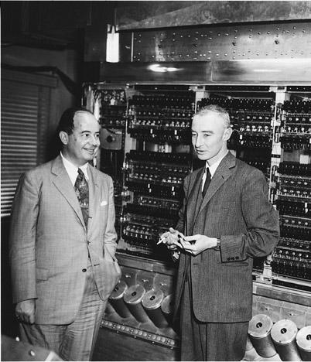
The von Neumann Architecture
One of the foundational ideas of modern computing—traditionally attributed to John von Neumann although others can make valid claims to the idea—is that code is stored in the same memory as data. This concept is called the stored programming model.
If you go on to take the Computer Organization course, you will learn more about how code is represented inside the computer. For now, the important idea is that the code for every C++ function is stored somewhere in memory and therefore has an address.
0000
0004
int main() {
cout << "hello";
cout << endl;
return 0;
}
0008
000C
0010
0014
0018
001C
0020
0024
0028
.
.
.
002C
FFD0
FFD4
FFD8
FFDC
FFE0
FFE4
John von Neumann and J. Robert Oppenheimer
FFE8
FFEC
FFF0
FFF4
FFF8
FFFC

Slide 20
Callback Functions
The ability to determine the address of a function makes it possible to pass functions as parameters to other functions.
In this example, the function main makes two calls to plot.
The first call passes the address of sin, which is 0028.
The second passes the address of cos, which is 0044.
The plot function can call this function supplied by the caller. Such functions are known as callback functions.
int main() {
GWindow gw;
plot(gw, sin, . . .);
plot(gw, cos, . . .);
return 0;
}
0000
0004
0008
000C
0010
0014
0018
001C
0020
double sin(double x) {
. . . code to compute sin(x) . . .
}
0024
0028
002C
0030
0034
0038
003C
double cos(double x) {
. . . code to compute cos(x) . . .
}
0040
0044
0048
004C
0050
0054
0058
005C
0060
0064

Slide 21
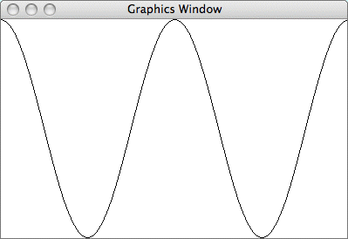
Plotting a Function
This section defines a plot function that draws the graph of a function on the graphics window.
The arguments to plot are the graphics window, the function, and the limits in the x and y directions. For example, calling
produces the following output:
plot(gw, cos, -2 * PI, 2 * PI, -1.0, 1.0);

Slide 22
Example: Defining the plot Function
What is the prototype for the plot function?
How would you convert values x and y in the mathematical domain into screen points sx and sy?
Hint: In the time that x moves from minX to maxX, sx must move from 0 to gw.getWidth(); y must move in the opposite direction from gw.getHeight() to 0.
void plot(GWindow & gw, double (*fn)(double),
void plot(GWindow & gw, double minX, double maxX,
void plot(GWindow & gw, double minY, double maxY);
double width = gw.getWidth();
double height = gw.getHeight();
double nSteps = int(width);
double dx = (maxX - minX) / nSteps;
double sx0 = 0;
double sy0 = height - (fn(minX) - minY) / (maxY - minY) * height;
for (int i = 1; i < nSteps; i++) {
double x = minX + i * dx;
double y = fn(x);
double sx1 = (x - minX) / (maxX - minX) * width;
double sy1 = height - (y - minY) / (maxY - minY) * height;
gw.drawLine(sx0, sy0, sx1, sy1);
sx0 = sx1;
sy0 = sy1;
}

Slide 23
Function Pointers in C++
One of the hardest aspects of function pointers in C++ is writing the type for the function used in its declaration.
The syntax for declaring function pointers is consistent with the syntax for other pointer declarations, although it takes some getting used to. Consider the following declarations:
double x; | Declares x as a double.
double list[n]; | Declares list as an array of n doubles.
double *px; | Declares px as a pointer to a double.
double **ppx; | Declares ppx as a pointer to a pointer to a double.
double f(double); | Declares f as a function taking and returning a double.
double *g(double); | Declares g as a function taking a double and returning a pointer to a double.
double (*fn)(double); | Declares fn as a pointer to a function taking and returning a double.

Slide 24
Mapping Functions
The ability to work with pointers to functions offers one solution to the problem of iterating through the elements of a collection. To use this approach, the collection must export a mapping function that applies a client-specified function to every element of the collection.
Most collections in the Stanford libraries export the method that calls fn on every element of the collection.
As an example, you can print the elements of an integer vector Vector<int> v, by calling v.mapAll(printInt) where printInt is
template <typename ValueType>
void mapAll(void (*fn)(ValueType));
void printInt(int n) {
cout << n << endl;
}

Slide 25
Implementing Mapping Functions
/*
* Implementation notes: mapAll
* ----------------------------
* This method uses a for loop to call fn on every element.
*/
template <typename ValueType>
void Vector<ValueType>::mapAll(void (*fn)(ValueType)) const {
for (int i = 0; i < count; i++) {
fn(array[i]);
}
}

Slide 26
Implementing Mapping Functions

Slide 27
Implementing Mapping Functions
Exercise: Implement the mapping function
as part of the hashing based StringMap class, for which the private section looks like this:
void mapAll(void (*fn)(string));
/* Type definition for cells in the bucket chain */
struct Cell {
std::string key;
std::string value;
Cell *link;
};
/* Constant definitions */
static const int INITIAL_BUCKET_COUNT = 13;
/* Instance variables */
Cell **buckets; /* Dynamic array of pointers to cells */
int nBuckets; /* The number of buckets in the array */

Slide 28
Using mapAll to Iterate
As an example, the Lexicon class exports a mapping function called mapAll with the signature
The existence of mapAll in the Lexicon class makes it possible to recode the TwoLetterWords program as
void mapAll(void (*fn)(string));
void printTwoLetterWords(string word) {
if (word.length() == 2) {
cout << word << endl;
}
}
int main() {
Lexicon english("EnglishWords.dat");
english.mapAll(printTwoLetterWords);
return 0;
}

Slide 29
Exercise: KLetterWords
If you use the range-based for loop, this function is straightforward to code:
If you try to use the mapAll method instead, the callback function needs access to the value of k, the client must somehow pass k to the mapping function of the collection class, which must then turn around and pass that same value back to the client’s callback function.
void listWordsOfLengthK(const Lexicon & lex, int k) {
for (string word : lex) {
if (word.length() == k) {
cout << word << endl;
}
}
}

Slide 30
Passing Data to Mapping Functions
The biggest problem with using mapping functions is that it is difficult to pass client information from the client back to the callback function. The C++ packages that support callback functions typically support two different strategies for achieving this goal:
Passing an additional argument to the mapping function, which is then included in the set of arguments to the callback function.
Passing a function object to the mapping function. A function object is simply any object that overloads the function-call operator, which is designated in C++ as operator().
The text goes through each of these strategies in the context of a program that writes out every word in the English lexicon that has a particular length.

Slide 31
Passing Data Using Function Object
Now you can list the words in the lexicon whose length is k by passing k to the callback function ListKLetterWords through the mapping function mapAll.
class ListKLetterWords {
public:
ListKLetterWords(int k) {
this->k = k;
}
int operator()(string word) {
if (word.length() == k) {
cout << word << endl;
}
}
private:
int k; /* Length of desired words */
};
void listWordsOfLengthK(const Lexicon & lex, int k) {
lex.mapAll(ListKLetterWords(k));
}

Slide 32
/* Method: mapAll
* Usage: lexicon.mapAll(fn);
* --------------------------
* Calls the specified function on each word in the lexicon.
*/
void mapAll(void (*fn)(std::string)) const;
void mapAll(void (*fn)(const std::string&)) const;
template <typename FunctorType>
void mapAll(FunctorType fn) const;
void Lexicon::mapAll(void (*fn)(std::string)) const {
for (std::string word : m_allWords) {
fn(word);
}
}
void Lexicon::mapAll(void (*fn)(const std::string&)) const {
for (std::string word : m_allWords) {
fn(word);
}
}
template <typename FunctorType>
void Lexicon::mapAll(FunctorType fn) const {
for (std::string word : *this) {
fn(word);
}
}

Slide 33
Example: Function Objects
int main() {
AddKFunction add1 = AddKFunction(1);
AddKFunction add17 = AddKFunction(17);
cout << "add1(100) -> " << add1(100) << endl;
cout << "add17(25) -> " << add17(25) << endl;
return 0;
}

Slide 35
Another Use of Iterators in C++
Besides their original purpose of stepping through the elements of a collection, iterators have even greater importance in C++ because so many of the functions in the Standard Template Library take iterators as parameters.
To sort all the elements of a vector v, you call
If you wanted to sort only the first k elements of v, you could call
The sort function in the STL is only one of many useful functions exported by the <algorithm> interface.
sort(v.begin(), v.end());
sort(v.begin(), v.begin() + k);

Slide 36
Methods in the algorithm Library
max(x, y)
Returns the greater of x and y.
min(x, y)
Returns the lesser of x and y.
swap(x, y)
Swaps the reference parameters x and y.
iter_swap(i₁, i₂)
Swaps the values addressed by the iterators i₁ and i₂.
binary_search(begin, end, value)
Returns true if the iterator range contains the specified value.
copy(begin, end, out)
Copies the iterator range to the output iterator.
count(begin, end, value)
Counts the number of values in the iterator range that are equal to value.
fill(begin, end, value)
Sets every element in the iterator range to value.

Slide 37
Methods in the algorithm Library
find(begin, end, value)
Returns an iterator to the first element in the iterator range that is equal to value.
merge(begin₁, end₁, begin₂, end₂, out)
Merges the sorted input sequences into the output iterator.
min_element(begin, end)
Returns an iterator to the smallest element in the iterator range.
max_element(begin, end)
Returns an iterator to the largest element in the iterator range.
random_shuffle(begin, end)
Randomly reorders the elements in the iterator range.
replace(begin, end, old, new)
Replaces all occurrences of old with new in the iterator range.
reverse(begin, end)
Reverses the elements in the iterator range.
sort(begin, end)
Sorts the elements in the iterator range.

Slide 38
Methods in the algorithm Library
for_each(begin, end, fn)
Calls fn on every value in the iterator range.
count_if(begin, end, pred)
Returns the number of elements in the iterator range for which pred is true.
replace_if(begin, end, pred, new)
Replaces every element in the iterator range for which pred is true by new.
partition(begin, end, pred)
Reorders the elements in the iterator range so that the pred elements come first.

Slide 39
Using the algorithm Library
One more way to print two-letter words:
The callback function can also be a function object:
void printTwoLetterWords(string word) {
if (word.length() == 2) {
cout << word << endl;
}
}
int main() {
Lexicon english("EnglishWords.dat");
for_each(english.begin(), english.end(), printTwoLetterWords);
return 0;
}
for_each(lex.begin(), lex.end(), ListKLetterWords(k));

Slide 40
Using the algorithm Library
Selection sort in the original form:
Selection sort using iterators and the algorithm library:
void sort(Vector<int> & vec) {
int n = vec.size();
for (int lh = 0; lh < n; lh++) {
int rh = lh;
for (int i = lh + 1; i < n; i++) {
if (vec[i] < vec[rh]) rh = i;
}
int temp = vec[lh];
vec[lh] = vec[rh];
vec[rh] = temp;
}
}
void sort(Vector<int> & vec) {
for (Vector<int>::iterator lh = vec.begin(); lh != vec.end(); lh++) {
Vector<int>::iterator rh = min_element(lh, vec.end());
iter_swap(lh, rh);
}
}

Slide 41
Programming Paradigms
A programming paradigm is a style or “way” of programming. One of the characteristics of a programming language is its support for particular paradigms. Some languages make it easy to write in some paradigms but not others.
A language purposely designed to allow programming in many paradigms is called a multi-paradigm programming language, e.g., C++, Python. You can write programs or libraries that are largely procedural, object-oriented, or functional (i.e., some typical paradigms) in these languages. In a large program, even different sections can be written in different paradigms.
C++ supports the procedural and object-oriented paradigms naturally, supports the functional paradigm through the <functional> interface, and supports many other paradigms through various external libraries.

Slide 42
Programming Paradigms
Imperative: An explicit sequence of statements that change a program's state, specifying how to achieve the result.
Structured: Programs have clean, goto-free, nested control structures.
Procedural: Imperative programming with procedures operating on data.
Object-Oriented: Computation is effected by sending messages to objects; objects have states and behavior.
Class-based: Objects get their states and behavior based on membership in a class.
Prototype-based: Objects get their behavior from a prototype object.
Declarative: Programs state the logic of a computation (what is the result you want), but not its control flow (how to get it).
Functional: Computation proceeds by (nested) function calls that avoid any global state.
Logic: Programmer specifies a set of facts and rules, and an engine infers the answers to questions.

Slide 43
Functional Programming in C++
Even though functional programming was not a goal of the language design, the fact that C++ includes both templates and function objects make it possible to adopt a programming style that is remarkably close to the functional programming model, which is characterized by the following properties:
Programs are expressed in the form of nested function calls that perform the necessary computation without performing any operations (such as assignment) that change the program state.
Functions are data values and can be manipulated by the programmer just like other data values.
STL offers rudimentary support for the functional programming paradigm through the <functional> interface, which exports a variety of classes and methods, which generally fall into two categories represented by the template class binary_function that take two arguments, and unary_function that take a single argument.

Slide 44
Classes in the functional Library
binary_function<argtype₁, argtype₂, resulttype>
Superclass for functions that take the two argument types and return a resulttype.
unary_function<argtype, resulttype>
Superclass for functions that take one argtype and return a resulttype.
plus<type>
Binary function implementing the + operator.
minus<type>
Binary function implementing the - operator.
multiplies<type>
Binary function implementing the * operator.
divides<type>
Binary function implementing the / operator.
modulus<type>
Binary function implementing the % operator.
negate<type>
Unary function implementing the - operator.

Slide 45
Classes in the functional Library
equal_to<type>
Function class implementing the == operator.
not_equal_to<type>
Function class implementing the != operator.
less<type>
Function class implementing the < operator.
less_equal<type>
Function class implementing the <= operator.
greater<type>
Function class implementing the > operator.
greater_equal<type>
Function class implementing the >= operator.
logical_and<type>
Function class implementing the && operator.
logical_or<type>
Function class implementing the || operator.
logical_not<type>
Function class implementing the ! operator.

Slide 46
Methods in the functional Library
bind1st(fn, value)
Returns a unary counterpart to the binary fn in which the first argument is value.
bind2nd(fn, value)
Returns a unary counterpart to fn in which the second argument is value.
not1(fn)
Returns a unary predicate function which has the opposite result of fn.
not2(fn)
Returns a binary predicate function which has the opposite result of fn
ptr_fun(fnptr)
Converts a function pointer to the corresponding function object.

Slide 47
Using the functional Library
You can arrange an integer vector v in reverse order:
You can count the number of negative values in an integer vector v by a single line using both the algorithm and functional libraries and iterators:
sort(vec.begin(), vec.end(), greater<int>());
int neg = count_if(v.begin(), v.end(), bind2nd(less<int>(), 0));

Slide 48
The End

